Slide 1
Conceptualizing Interactions
SAMIA ARSHAD

Slide 2
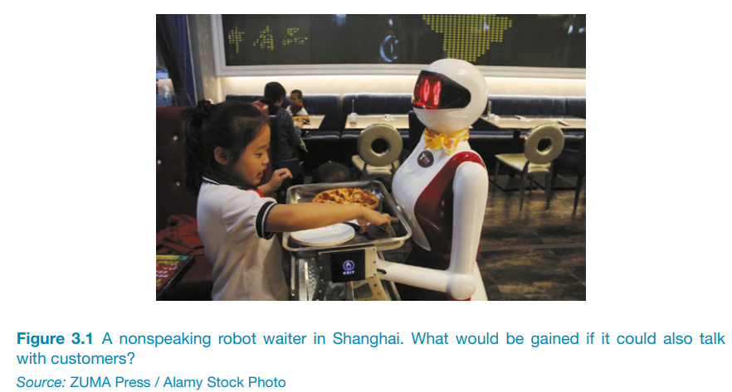
Introduction
Proof of concept: conceptualize ideas in terms of what the proposed product will do.

Slide 3
Conceptualizing Interaction
It is important to be clear about underlying assumptions and claims.
Assumptions: taking something for granted that needs further investigation.
Claims: stating something to be true when it is still open to question.

Slide 4
Framework to Conceptualized Interactions
Framework to aid design team in conceptualizing interactions
Are there problems with an existing product or user experience? If so, what are they?
Why do you think there are problems?
What evidence do you have to support the existence of these problems?
How do you think your proposed design ideas might overcome these problems?

Slide 5
Benefits of Conceptualization
Orientation Enabling the design team to ask specific kinds of questions about how the conceptual model will be understood by the targeted users.
Open-Mindedness Allowing the team to explore a range of different ideas to address the problems identified.
Common Ground Allowing the design team to establish a set of common terms that all can understand and agree upon, reducing the chance of misunderstandings and confusion arising later.

Slide 6
Conceptual Model
Model
A model is a simplified description of a system and process that help describe how it works.
Conceptual Model
Particular kind of model used in interaction design intended to articulate the problem and design space.

Slide 7
More Definitions
A highlevel definition of how a system is organized and operates
Designers to straighten out their thinking before the start laying out their widgets
-Jeff and Autsin

Slide 8
Components of Conceptual Model
Metaphors and Analogies
To understand what a product is used for and how to use it
The Concepts to which people are exposed through the product
The relationship between those concepts
The mapping between the concepts

Slide 9
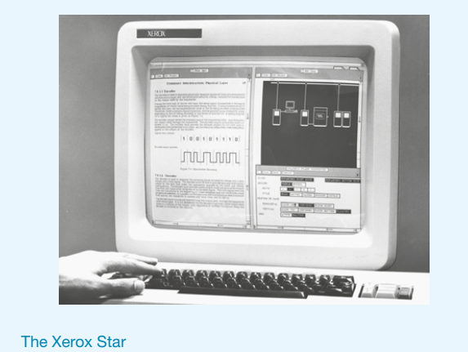
New Conceptual Model
Its rare for completely new conceptual models to emerge that transform the way daily work activities are carried out at an interface.
The Desktop (GUI)
Digital Spreadsheet
World Wide Web

Slide 10
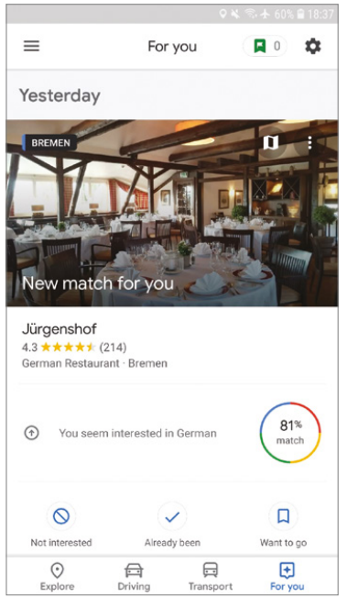
Interface Metaphors
Central component of conceptual model
Similar to familiar entity but have their own behavior and properties.
For example
Desktop
Browser
Recycle bin
Cart
Checkout
Card
Intended to readily understand the underlaying conceptual model.

Slide 11
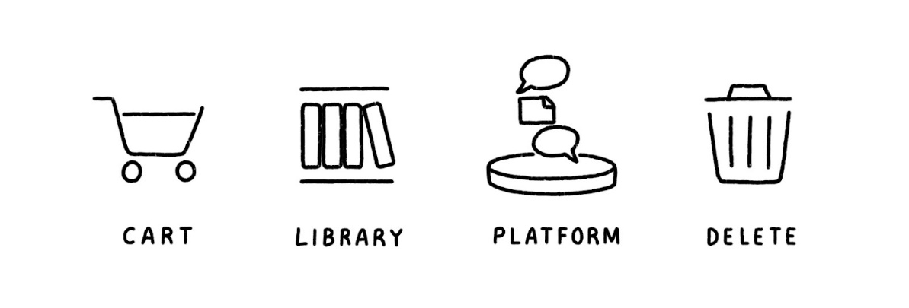
Usage of Metaphors
As a way of conceptualizing what we are doing (for instance, surfing the web)
As a conceptual model instantiated at the interface level (for example, the card metaphor)
As a way of visualizing an operation (shopping cart)

Slide 12
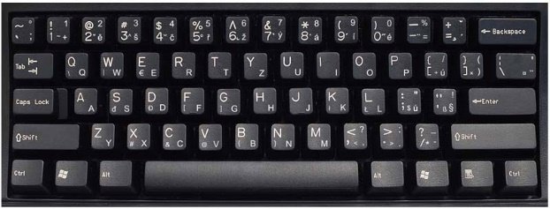
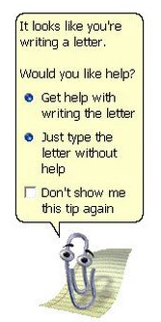
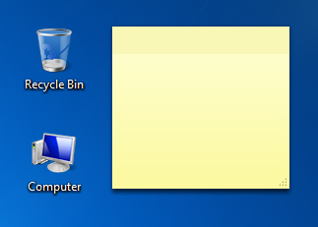
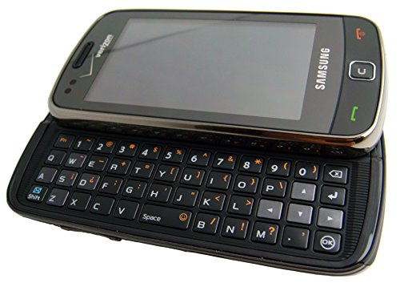
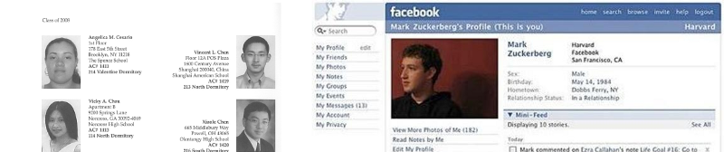
Metaphors and Analogies

Slide 13
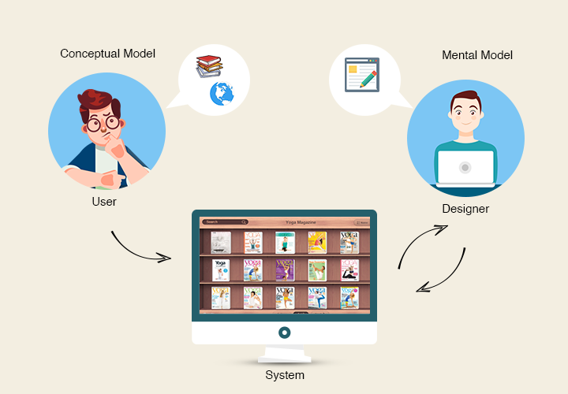
Interaction Types
Ways of interaction with a product or application
Instructing
Conversing
Manipulating
Exploring
Responding
Deciding upon which on the interaction type to use and why, can help designers formulate a conceptual model before committing to a particular interface.

Slide 14
Interaction Type
Instructing: Where users issue instructions to a system.
(typing in commands, selecting options from menu, multitouch screen, speaking aloud commands, gesturing, pressing buttons, or using a combination of function keys)
Conversing: Where users have a dialog with a system.
(Users can speak via an interface or type in questions to which the system replies via text or speech output.)
Manipulating: Where users interact with objects in a virtual or physical space by manipulating them.
(for instance, opening, holding, closing, and placing).

Slide 15
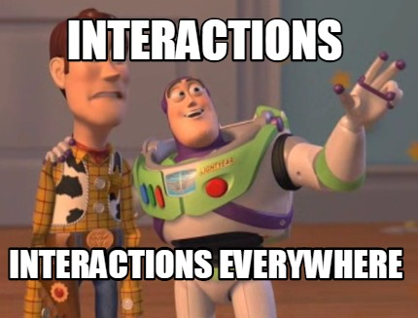
Interaction Type
Exploring: Where users move through a virtual environment or a physical space.
(Virtual environments include 3D worlds and augmented and virtual reality systems. Physical spaces that use sensor-based technologies include smart rooms and ambient environments)
Responding: Where the system initiates the interaction and the user chooses whether to respond.
(For example, proactive mobile location-based technology can alert people to points of interest. They can choose to look at the information popping up on their phone or ignore it)

Slide 16
Direct Manipulation
Enables users to directly control the digital objects represented by the computers.
Helping beginners learn basic functionality rapidly
Enabling experienced users to work rapidly on a wide range of tasks
Allowing infrequent users to remember how to carry out operations over time
Preventing the need for error messages, except rarely
Showing users immediately how their actions are furthering their goals
Reducing users’ experiences of anxiety
Helping users gain confidence and mastery and feel in control

Slide 17
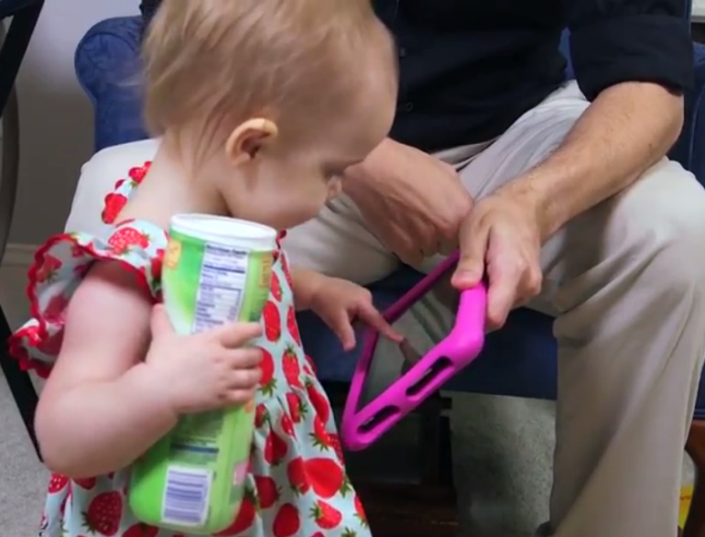
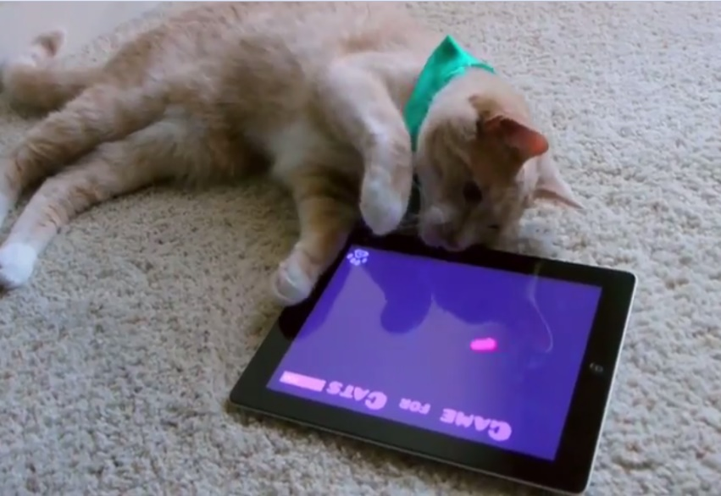
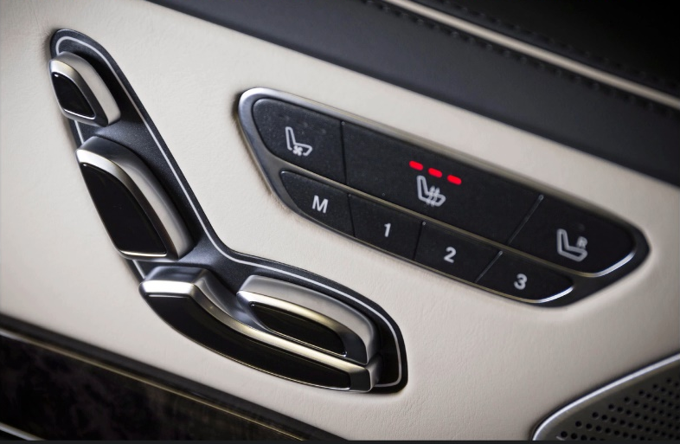
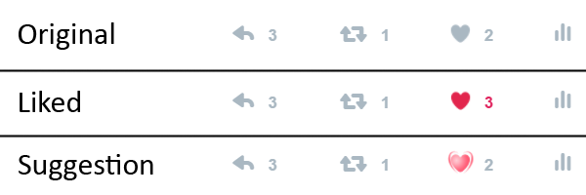
Examples Direct Manipulation

Slide 18
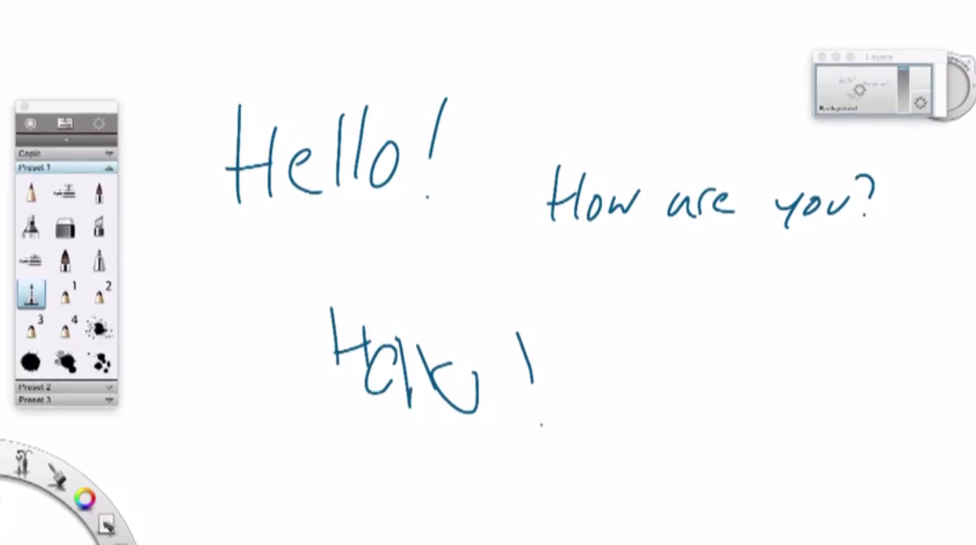
Stylus VS Mouse

Slide 19
More on Conceptual Model
Paradigms
Adopting a set of practices upon which a community has agreed.
Vision
Vision of the future
Theories
Cognitive, social, affective and organizational
Models
Aspects of human behavior or HCI
Frameworks
Offers advise to designers as to what to design and what to look for.

Slide 20
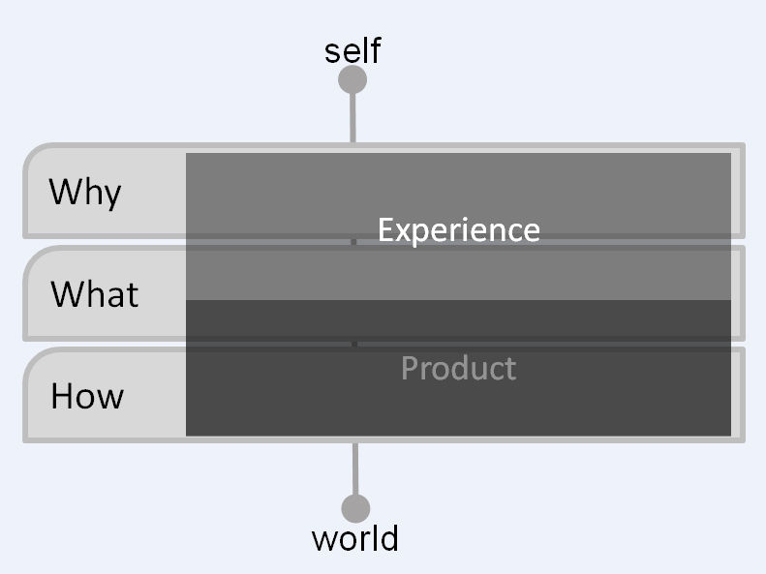
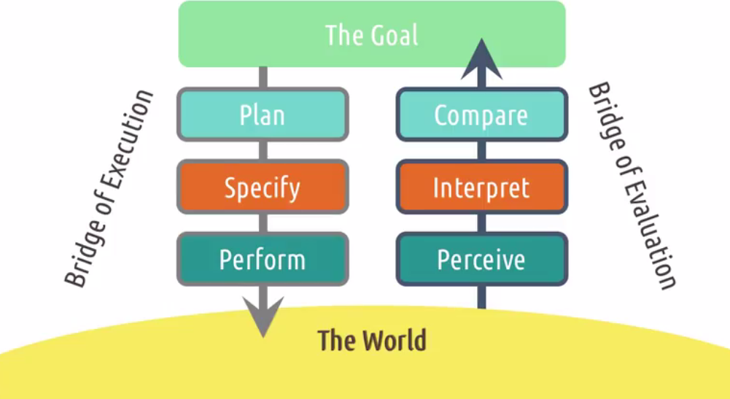
Examples of Models
Marc Hassenzahl’s (2010) model of experience design
Seven stages of interaction (Don Norman, 1988)

Slide 21
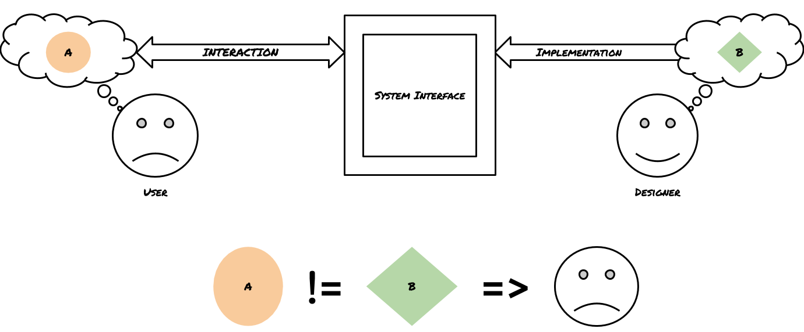
Example of Framework
Don Norman,1988

Slide 22
Conclusion
Conceptualizing Interactions
Conceptual Models
Interface Metaphors
Interaction Types
Paradigm, Vision, Theory, Model, Framework

Slide 23
Links to Watch
Xerox Star User Interface
Apple Knowledge Navigator
Internet of Things
Exploring Sacred Sites with Virtual Reality
Volkswagen I.D. VIZZION

